Slide 1
Bank Management and Credit Card Rewarding System
Group 14:
Pramoth Guhan
Akshaya Murugan

Slide 2
Problem Definition:
In our modern, fast-paced financial sector, disjointed bank operations and customer loyalty programs, particularly involving credit card rewards, lead to inefficiencies and poor customer experiences. Our project aims to develop an Integrated Bank Management and Credit Card Rewarding System to address these issues. This system will unify banking services with a personalized rewards program, enhancing operational efficiency and customer satisfaction. By leveraging real-time data analytics, the system will offer actionable insights into customer behaviors and market trends, driving strategic decision-making to improve customer loyalty and bank profitability. The challenge lies in designing and implementing a seamless system that revolutionizes traditional banking practices and fosters a more customer-centric experience.

Slide 3
Business Requirement:
Integrated System Development: Create a comprehensive system that seamlessly integrates bank management and credit card rewards, enhancing operational efficiency and customer engagement.
Loan-Branch Association: Enable each branch to effectively manage multiple loans, streamlining loan processing and tracking within the system.
Customer-Reward Program Engagement: Facilitate customer enrollment and participation in diverse reward programs, ensuring each program can support multiple participants.
Credit Card-Reward Point Relationship: Link reward points directly to credit card transactions, enabling customers to earn points based on spending patterns.
Redemption Option-Reward Point Conversion: Provide a variety of reward redemption options, each requiring different point amounts, to offer flexibility and choice to customers.
Customer-Redemption Requests: Allow customers to make and track multiple redemption requests over time, detailing the specific rewards they wish to claim.
Personalized Rewards: Implement a system that tailors rewards to individual customer preferences, enhancing satisfaction and promoting long-term loyalty.
Project Goal: Transform how banks manage operations and customer loyalty, driving innovation and excellence. The system will leverage data-driven insights for proactive management and strategic decisions, enhancing business growth and profitability.

Slide 4
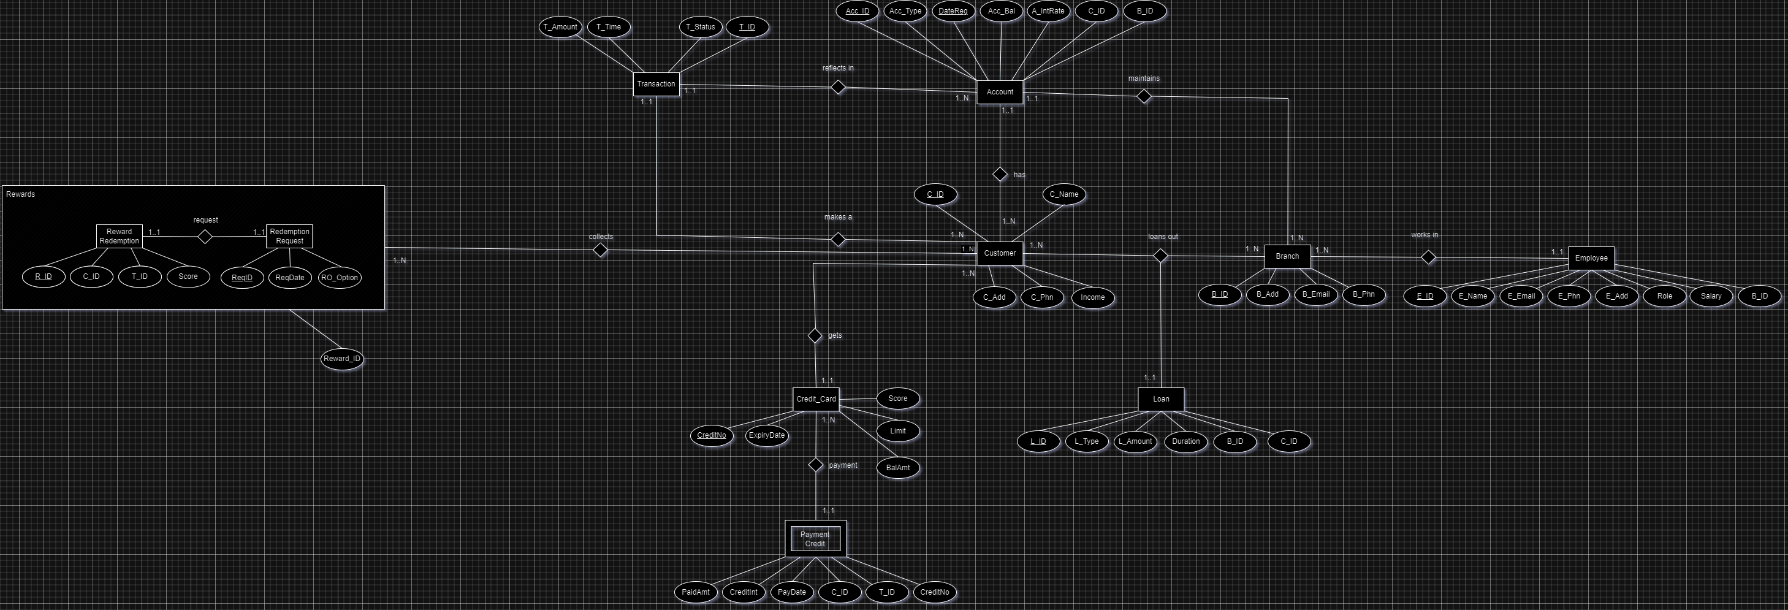
EER Diagram:

Slide 5
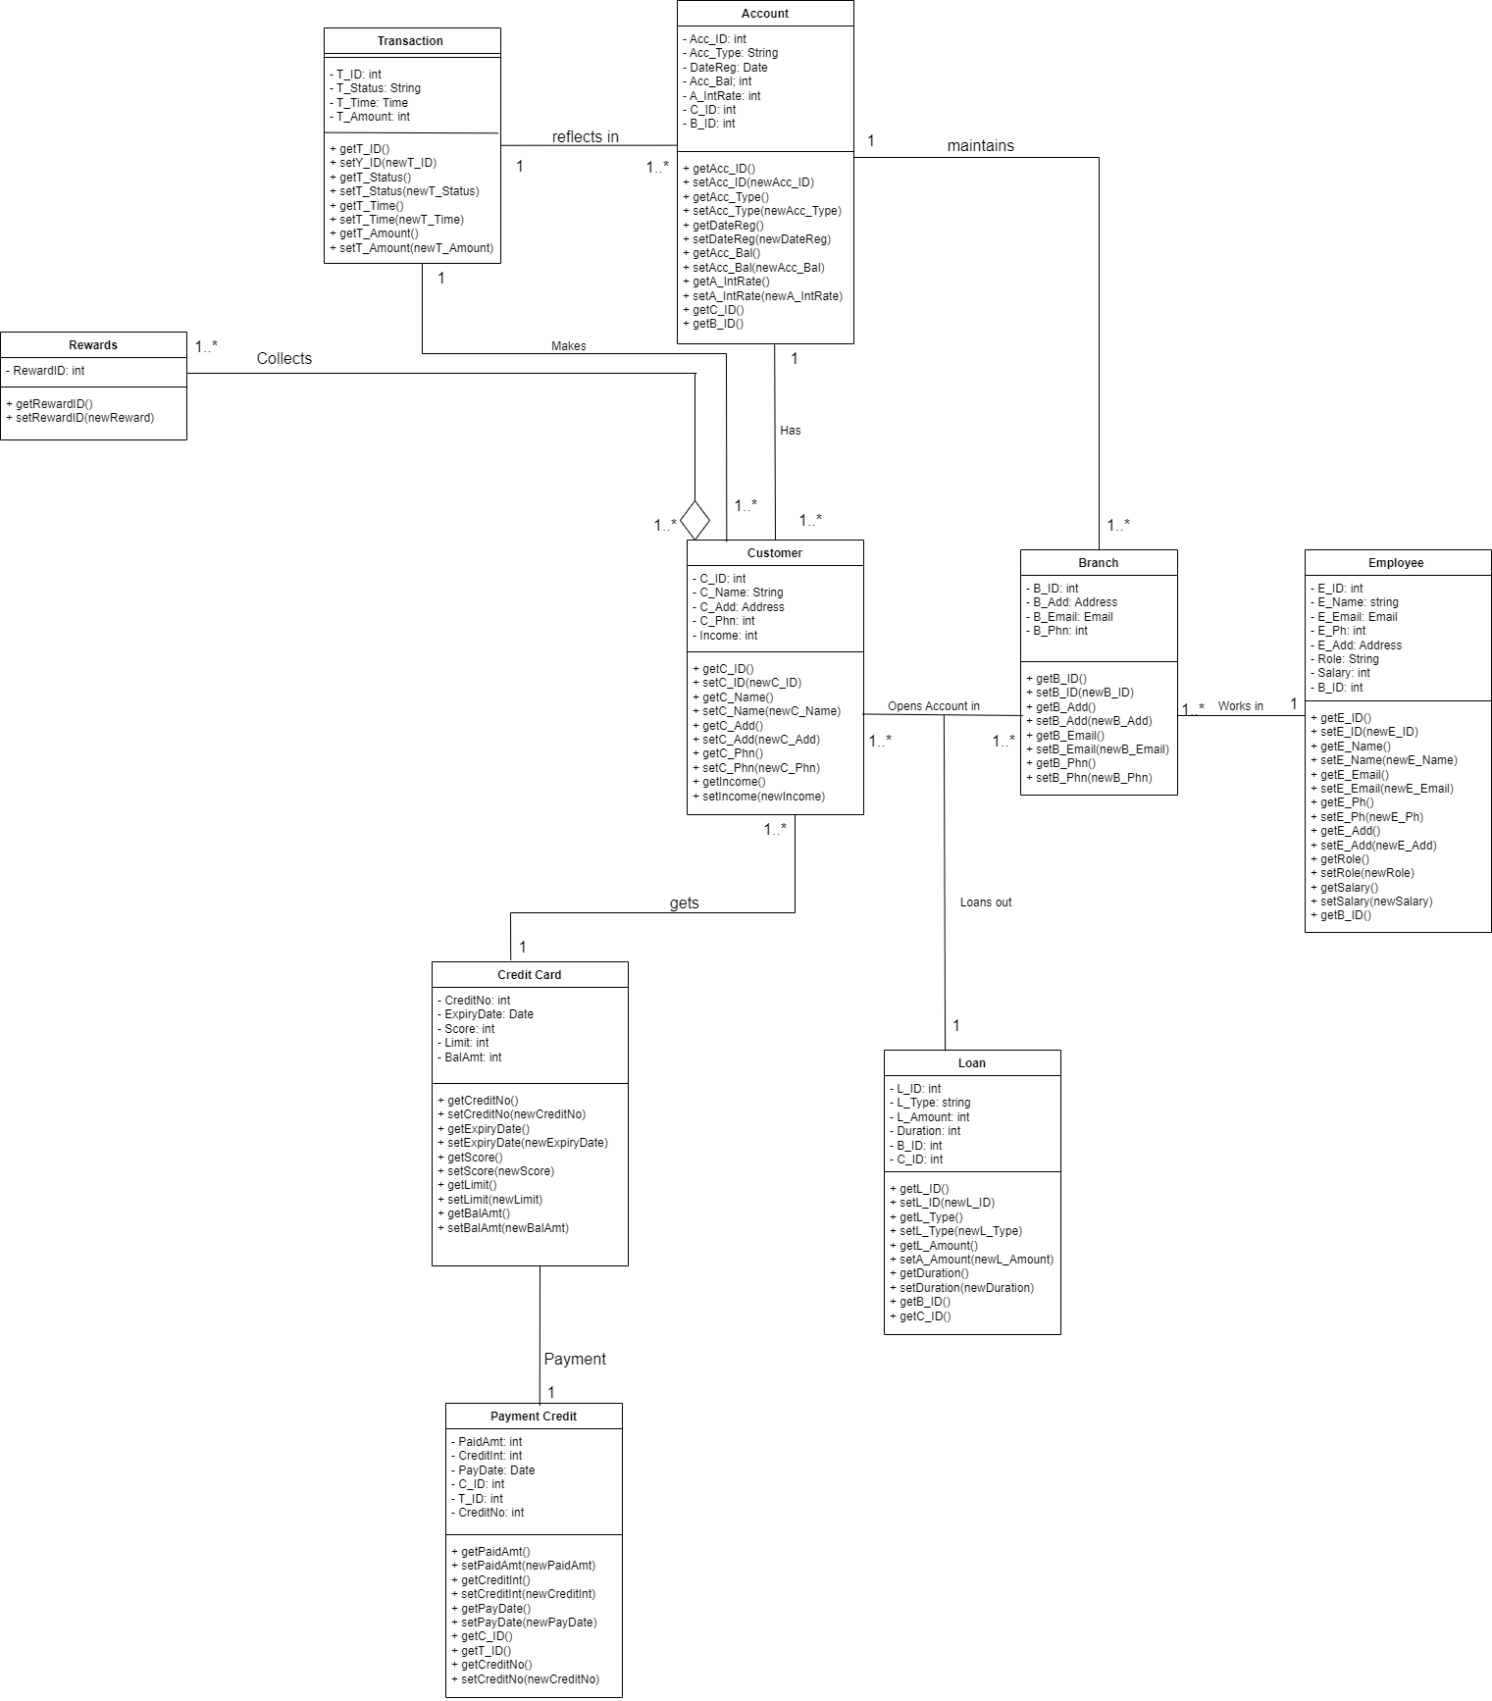
UML Diagram:

Slide 6
Relational Model:
BRANCH (BRANCH ID, BRANCH ADDRESS, BRANCH EMAIL, BRANCH PHONE NUMBER)
Primary key – BRANCH ID, NOT NULL;
ACCOUNT (ACCOUNT NUMBER, DATE REGISTERED, TYPE, ACCOUNT BALANCE, BRANCH ID)
Primary key – ACCOUNT NUMBER, DATE REGISTERED, both NOT NULL;
Foreign key – BRANCH ID from BRANCH relation, NOT NULL;
EMPLOYEE (EMPLOYEE ID, EMPLOYEE NAME, EMPLOYEE EMAIL, SALARY, BRANCH ID)
Primary key – EMPLOYEE ID, NOT NULL;
Foreign key – BRANCH ID from BRANCH relation, NOT NULL;
CUSTOMER (CUSTOMER ID, CUSTOMER NAME, CUSTOMER ADDRESS, CUSTOMER PHONE NO, INCOME, BRANCH ID)
Primary key – CUSTOMER ID, NOT NULL;
Foreign key – BRANCH ID from BRANCH, NOT NULL;
TRANSACTION (TRANSACTION ID, TRANSACTION AMOUNT, TRANSACTION TIME, STATUS, CUSTOMER ID)
Primary key – TRANSACTION ID, NOT NULL
Foreign key – CUSTOMER ID from CUSTOMER relation, NOT NULL;
LOAN (LOAN ID, LOAN TYPE, LOAN AMOUNT, LOAN DURATION, BRANCH ID, CUSTOMER ID)
Primary key – LOAN ID, NOT NULL;
Foreign key – BRANCH ID from BRANCH, CUSTOMER ID ID from CUSTOMER, NOT NULL;
CREDIT CARD (CREDIT CARD NUMBER, EXPIRY DATE, SCORE, LIMIT, BALANCE CREDIT, CSUTOMER ID)
Primary key – CREDIT CARD NUMBER, NOT NULL;
Foreign key – CUSTOMER ID from CUSTOMER relation, NOT NULL;
PAYMENT (PAID AMOUNT, DATE OF PAYMENT, CREDIT CARD NUMBER)
Foreign key – CREDIT CARD NUMBER from CREDIT CARD, NOT NULL
REWARD (REWARD ID, REWARD AMOUNT, REQUEST DATE, REDEMPTION OPTION, CUSTOMER ID)
Primary key – REWARD ID, NOT NULL;
Foreign key – CUSTOMER ID from CUSTOMER relation, NOT NULL;
MERCHANT(MERCHANT ID, MERCHANT NAME, CATEGORY, BRANCH ID, REWARD ID)
Primary key – MERCHANT ID, NOT NULL;
Foreign key – BRANCH ID from BRANCH relation, REWARD ID from REWARD relation, NOT NULL;

